Slide 1
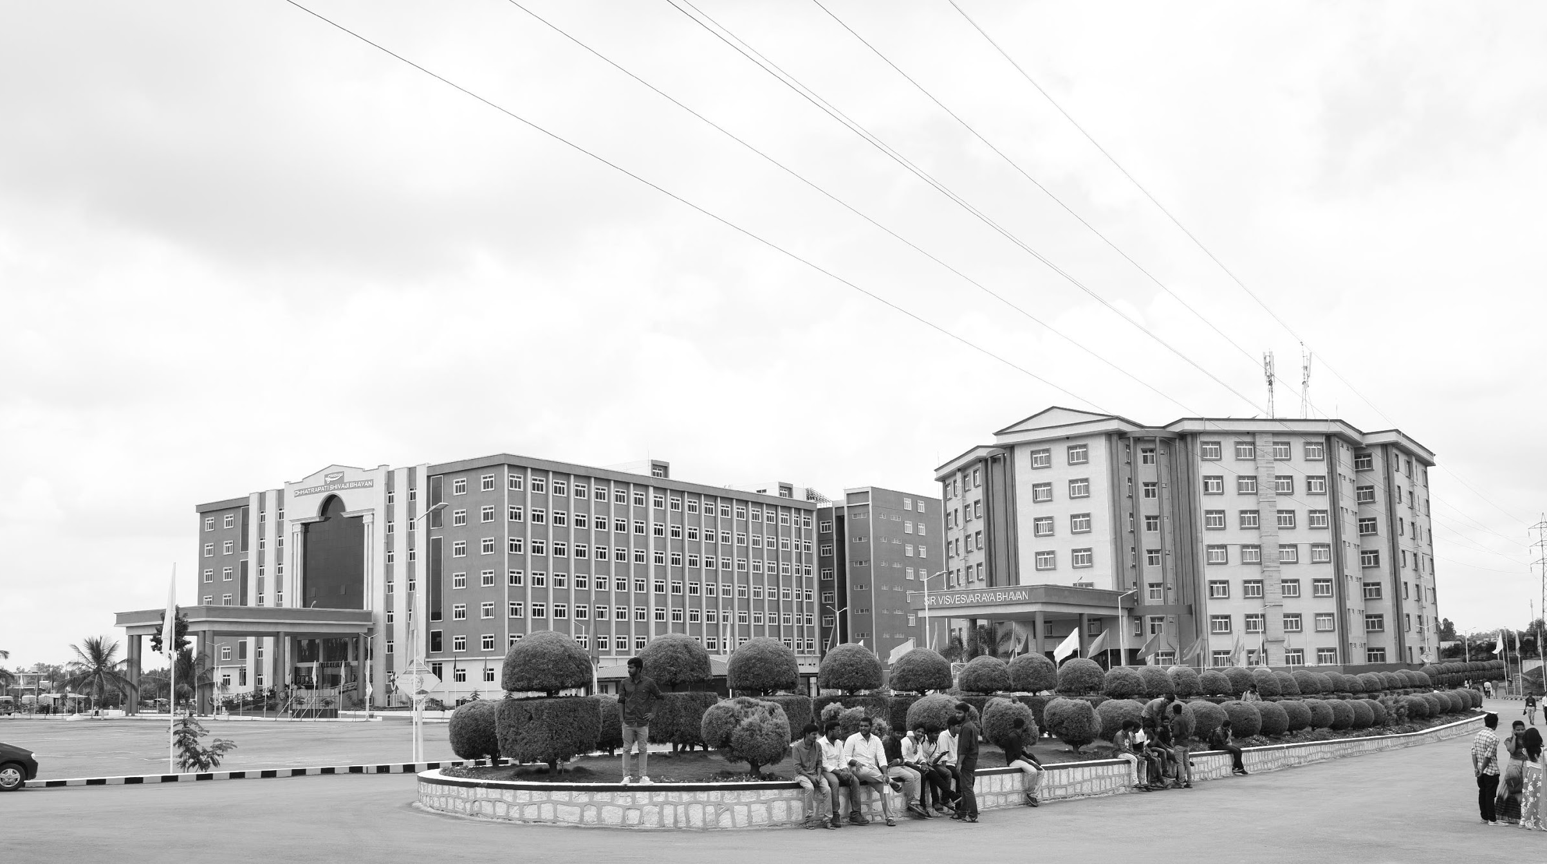

Medical Image Enhancement based on CLAHE Approach
Final Review 19/3/2025
Major Project
Project ID: CS10
AY 2021-25
GITAM (Deemed-to-be) University
Project Team:
Sathish Chandra B
Akhil S
Ansar S
Department of Electrical Electronics and Communication Engineering
Project Mentor:
Dr. Pankaj kandhway
Project In-charge:
Dr. Pankaj kandhway
www.gitam.edu

Slide 2
Objective and Goals
Abstract
In this project, we discuss the Medical Image Enhancing Method based on CLAHE approach. Medical image enhancement is crucial in digital image processing, as medical images often suffer from noise and low contrast issues. This paper proposes an advanced image enhancement approach that integrates Principal Component Analysis (PCA)-based fusion with multiple filtering techniques to improve image clarity and diagnostic accuracy. The process begins by extracting the three color channels from the retinal image. Each channel undergoes enhancement using Gaussian, CLAHE, Median, and Wiener filters, followed by PCA-based fusion to retain the most significant image features. This process is applied to all three color channels, and the final enhanced image is obtained through another PCA-based fusion step. The proposed method effectively reduces noise, enhances contrast, and preserves image details. Performance evaluation using metrics such as Peak Signal-to-Noise Ratio (PSNR), Structural Similarity Index (SSIM), Feature Similarity Index(FSIM), and Entropy demonstrates the efficiency of the approach. The results indicate that the method significantly enhances the quality of medical images, leading to improved visual perception and potentially aiding more accurate clinical diagnoses.

Slide 3
Objective and Goals
Objective
The objective of this study is to enhance medical images by implementing a structured approach. First, denoising of noisy RGB images is performed using filtering techniques to improve clarity and preserve essential details. Next, channel-wise enhancement is applied, where the Red, Green, and Blue channels are processed separately for better contrast adjustment. To retain the most significant image features while minimizing redundancy, Principal Component Analysis (PCA) fusion is utilized to merge the enhanced channels. Following this, Contrast-Limited Adaptive Histogram Equalization (CLAHE) is applied to enhance local contrast and improve the visibility of fine details. Finally, the output image is generated, ensuring high-quality enhancement that preserves structural details and improves diagnostic accuracy.
Goals
Main Goals
Denoising of Noisy RGB Images
Channel-wise Enhancement
Fusion of Results using PCA
Enhancement using CLAHE
Final Output Generation

Slide 4
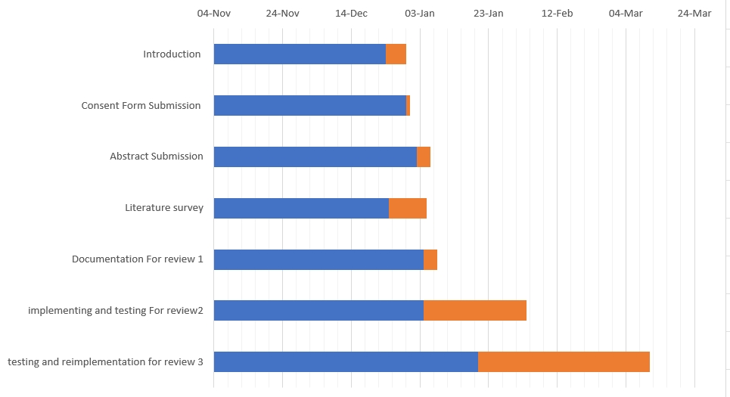
Project Plan
Gant Chart - Milestones and Activities

Slide 5
Literature Survey
Paper | Objective | Methodology | Key Findings | Limitations
Haddadi et al. (2024) | Improve medical image quality using CLAHE and POA | - CLAHE for contrast enhancement - Pelican Optimization Algorithm (POA) for estimating optimal clip-limit - Text-to-image stable diffusion for medical image generation | - Improved image quality and contrast - Enhanced visibility of medical details - Higher conformity rate in clinical diagnosis | - Noise over-amplification in CLAHE - Computational complexity due to POA
Sonali et al. (2019) An approach for de-noising and contrast enhancement of retinal fundus image using CLAHE | Enhance fundus image quality by reducing noise and improving contrast | - Applied CLAHE on RGB channels- Used median, Gaussian, Wiener, and mean filters- Evaluated with PSNR, SSIM, CoC, and EPI | - 7.85% improvement in PSNR- 1.19% improvement in SSIM- Enhanced edge preservation and detail clarity | - Noise amplification due to CLAHE- Green channel dependency
Rao et al. (2022) | Improve contrast and visibility in histopathology images | - Multiscale Retinex with Adaptive Weighting (MSRAW) - Weighted CLAHE (WCLAHE) on Lab* color space - Combined MSRAW and WCLAHE for global and local enhancement | - Enhanced histopathology image details - Preserved color balance and reduced noise - Improved local contrast and overall visibility | - Increased computational cost - Limited performance on certain color channels

Slide 6
Literature Survey (Improved post minor project
Paper | Objective | Methodology | Key Findings | Limitations
Dinh et al. (2022) | Enhance medical image contrast, noise reduction, and sharpness simultaneously | - Image decomposition into structure, texture, and noise - CLAHE for contrast enhancement - Marine Predators Algorithm (MPA) for parameter tuning | - Improved structural and texture details - Enhanced performance in medical image fusion - Increased image clarity and contrast | - Complexity in decomposition and parameter tuning - Sensitivity to initial parameter settings
Wen et al. (2016) | Enhance brightness and contrast of medical X-ray images | - Wavelet transformation to decompose image - Homomorphic filtering on low-frequency components - CLAHE for histogram modification | - Enhanced texture details and contrast - Better noise suppression compared to other methods | - High computational demand - Potential loss of detail in high-frequency regions

Slide 7
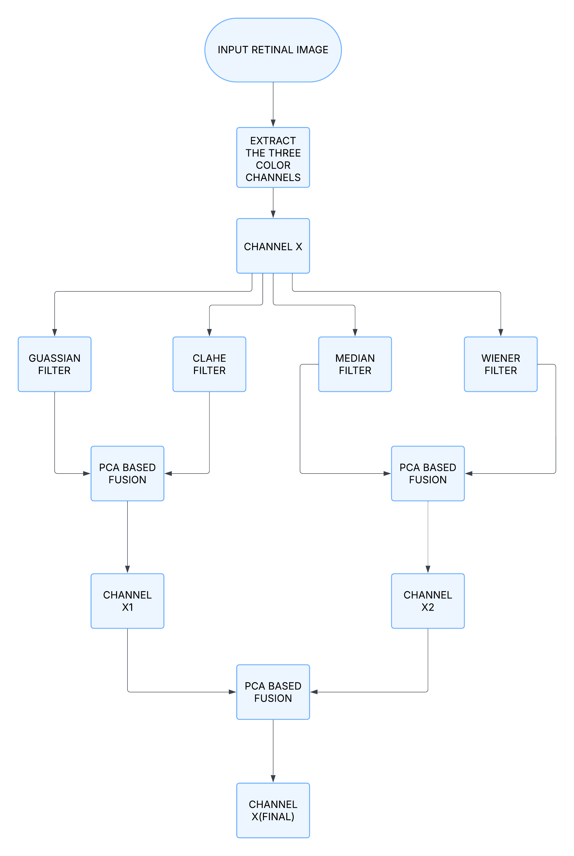
Architecture Flow chart

Slide 8
Use Cases & Testing
Use Cases
Medical Imaging Segment tumors and organs in MRI/CT scans by analyzing intensity and texture distributions.
Remote Sensing Classify land use (e.g., forests, water bodies) and detect changes using multi-band satellite images.
Industrial Inspection Identify defects in products by correlating features like color, texture, and intensity.
Autonomous Vehicles Detect objects and lanes for safe navigation using spatial and edge-based histograms.
Image Retrieval Enhance search accuracy in image databases by indexing color and texture features
Test Cases
An image with high dynamic range (HDR), where both bright and dark areas are captured with variations in color, intensity, and texture (e.g., a sunset with high contrast and color gradients).
Useful for assessing feature distribution in images with extreme variances.
Real-World Image with Complex Shadows and Multiple Features real-world image containing shadows, where the shadows create variations in intensity, texture, and color (e.g., a person standing under a tree with dappled lighting).
Tests how the histogram handles overlaps between features caused by shadows and highlights.
Highly Textured Multivariate Image

Slide 9
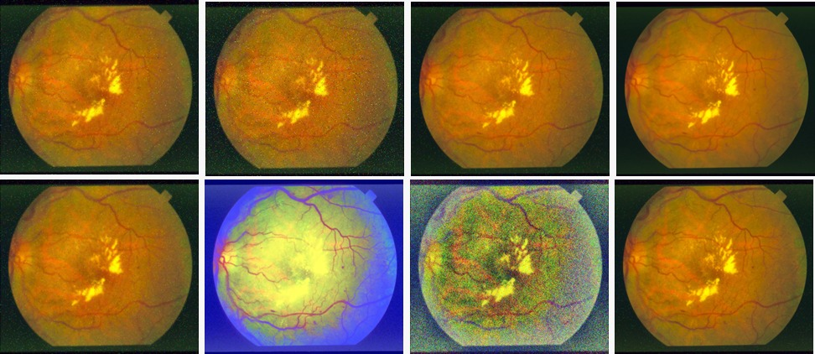
Implementation and Results
Results :
IMAGE-1(salt & pepper noise)
Fig.1.Original Image, Fig.2.Noisy Image, Fig.3.Gaussian filter, Fig.4.Median filter, Fig.5.Weiner filter, Fig.6.Histogram Equalization, Fig.7.CLAHE image, Fig.8.Proposed Image

Slide 10
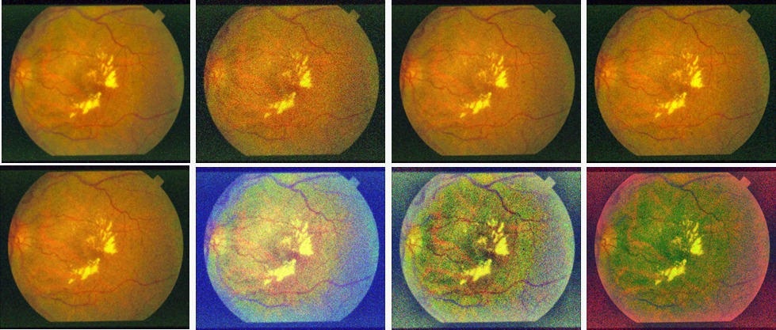
Implementation and Results
Results :
IMAGE-1(Gaussian noise)
Fig.1.Original Image, Fig.2.Noisy Image, Fig.3.Gaussian filter, Fig.4.Median filter, Fig.5.Weiner filter, Fig.6.Histogram Equalization, Fig.7.CLAHE image, Fig.8.Proposed Image

Slide 11
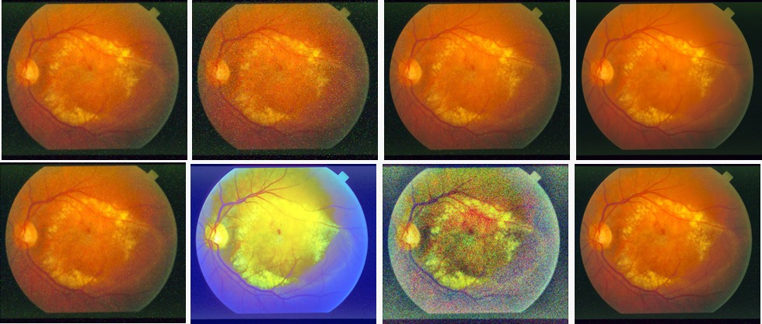
Implementation and Results
Results :
IMAGE-2(salt & pepper noise)
Fig.1.Original Image, Fig.2.Noisy Image, Fig.3.Gaussian filter, Fig.4.Median filter, Fig.5.Weiner filter, Fig.6.Histogram Equalization, Fig.7.CLAHE image, Fig.8.Proposed Image

Slide 12
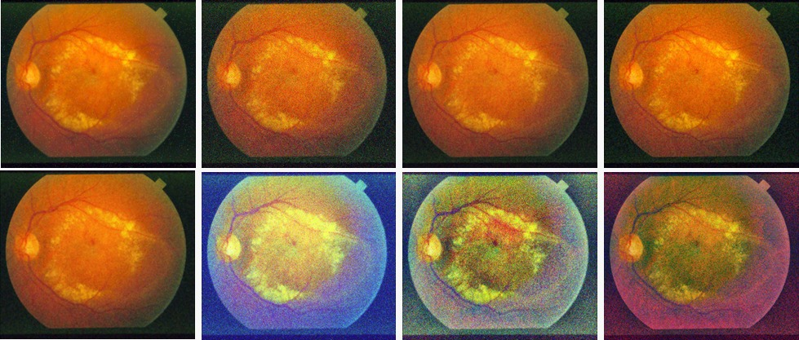
Implementation and Results
Results :
IMAGE-2(Gaussian noise)
Fig.1.Original Image, Fig.2.Noisy Image, Fig.3.Gaussian filter, Fig.4.Median filter, Fig.5.Weiner filter, Fig.6.Histogram Equalization, Fig.7.CLAHE image, Fig.8.Proposed Image

Slide 13
Contribution
Individual Contribution
Key contributions:
B Satish Chandra Kumar
Algorithm Development and Implementation and Data Analysis:
Designing and coding the CLAHE algorithm tailored for histopathology images.
Collaborated with other team members to integrate the enhancement algorithm into existing image processing frameworks.
Akhil S
Testing and Research
Focused on gathering and preparing a diverse dataset of histopathology images for testing.
Conducted a comprehensive literature review on image enhancement techniques, particularly CLAHE and its applications in medical imaging.
Syed Mohammad Ansar s
Documentation
Documented the entire development process, including methodologies, challenges, and results, ensuring clear communication within the team.

Slide 14
Conclusion & Future Work
Summary and Conclusion
In this study, we explored and compared various image enhancement techniques, including CLAHE, Gaussian filtering, and Histogram Equalization, against our proposed method. Medical images often suffer from noise, low contrast, and poor visibility, making enhancement crucial for accurate diagnosis. Our approach integrates CLAHE, PCA-based fusion, and multiple filtering techniques to enhance image contrast, reduce noise, and preserve important structural details. Performance evaluation metrics such as PSNR, FSIM, SSIM, and entropy demonstrated the superior effectiveness of our method in producing high-quality enhanced images
Future Work
In future research, we aim to further refine our approach by integrating deep learning-based enhancement models and real-time processing techniques, which could lead to even more efficient, adaptive, and automated image enhancement systems. The findings of this study highlight the potential of advanced image enhancement techniques in improving medical imaging workflows and enabling more reliable clinical decision-making.

Slide 15
THANK YOU
Have a Great Day !

